Slide 1
Lecture 13
Deep Learning I

Slide 2
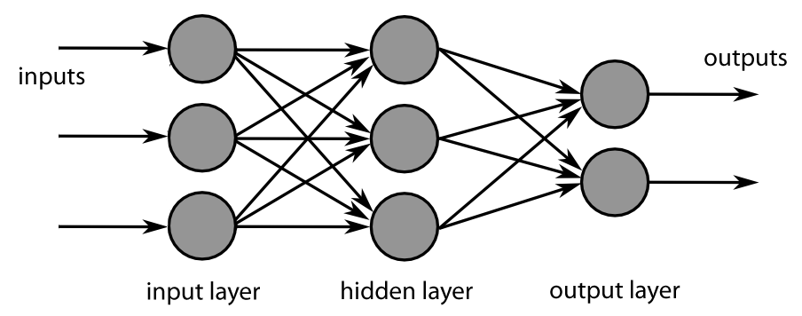
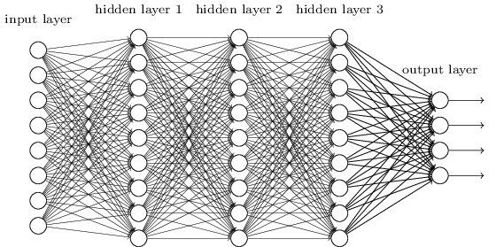
What is deep about “deep learning”?
Shallow Neural Network
Can be feed-forward or recurrent.
1 or 2 layers between input and output.
Typically, all layers except Input have similar functionality.
https://blog.paralleldots.com/data-science/challenges-in-deep-learning/
Deep Neural Network
Can be feed-forward or recurrent.
3 or more layers between input and output.
Different layers may have very different functionality.
http://neuralnetworksanddeeplearning.com/chap6.html

Slide 3
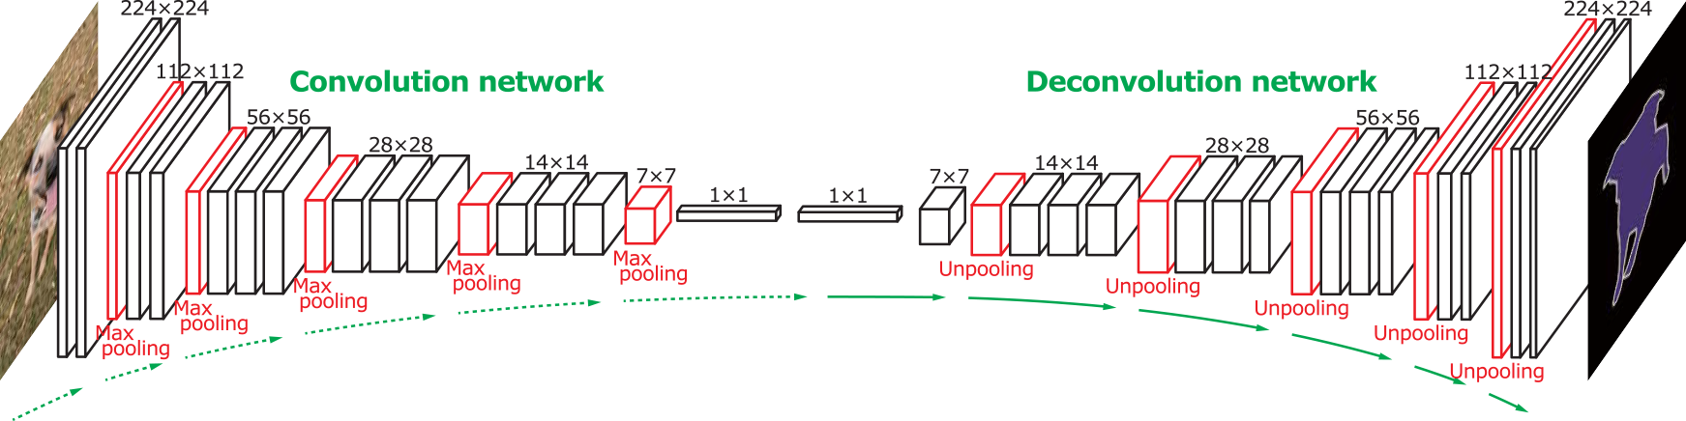
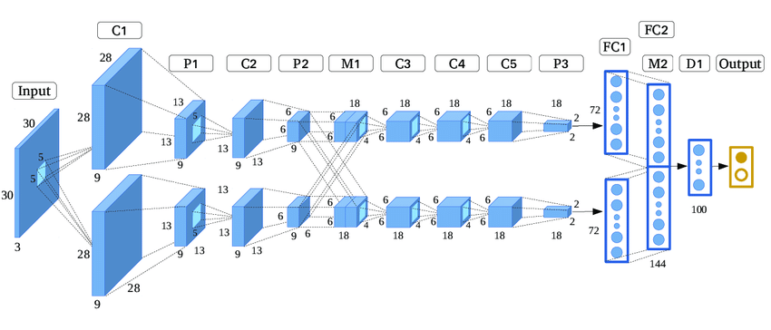
Sometimes, the networks can get very deep …..
http://mlcenter.postech.ac.kr/deep_learning
….. or have multiple streams.
https://pdfs.semanticscholar.org/e819/4fdd1191c804b2af324d8ab05913072ce221.pdf

Slide 4
Why are deep networks useful?
A layer of neurons can provide various types of transformations:
Re-mapping to a new feature space.
Compression to lower dimensional feature space.
Expansion to higher dimensional feature space.
Filtering of the input data.
Discretization of the input data.
Clustering of input data.
Classification of the input data.
Integration of current and previous inputs/outputs (memory).
Noise removal.
Pattern completion.
Deep networks allow us to combine layers with different functions to accomplish complicated tasks.

Slide 5
Why has deep learning become popular only recently?
We now have much faster computers.
We now have a lot of data (images, video, texts, etc.) that requires more complicated processing.
Better methods have recently been developed to design and train deep networks.
Several powerful new deep network models have been developed recently.

Slide 6
Classic Deep Learning Models
Feed-Forward
Deep feed-forward networks
(Classification, prediction, pattern recognition, etc.)
Auto-encoders
(Dimensionality reduction, feature extraction, generative models)
Convolutional networks (CNN)
(Image and video analysis, language analysis, etc.)
Recurrent
Deep recurrent networks
(Time-series prediction, sequence analysis, natural language processing, etc.)
Long short-term memory (LSTM)
(Sequence analysis, natural language processing, etc.)
Deep belief networks (DBN)
(Classification, prediction, pattern recognition, feature extraction, language analysis, etc.)
A useful tutorial: https://lilianweng.github.io/lil-log/2017/06/21/an-overview-of-deep-learning.html#recurrent-neural-network

Slide 7
Autoencoder
A multi-layer feed-forward neural network that is trained to reproduce its input vector as output.
Autoencoders typically – but not always – use hidden layers that are smaller than the input/output size.
y₁
x₁
Output Layer
Input Vector
H₁
H_{k}
H_{q}
x_{n}
y_{n}
For a nice introduction, see:
http://www.subsubroutine.com/sub-subroutine/2015/7/15/how-neural-net-autoencoders-can-automatically-abstract-visual-features-from-handwriting

Slide 8
Shallow Autoencoder
x₁
y₁
Hidden
Layer
x₂
y₂
x₃
y₃
x₄
y₄
x_{n-1}
y_{n-1}
x_{n}
y_{n}
+1
Bias

Slide 9
Building Multi-Stage Autoencoders
x₁
y₁
Input
H₁
Output
H₁
H₂
H₁
x_{n}
y_{n}
Stage 1
Stage 2
x₁
y₁
Input
H₁
H₂
H₁
Output
x_{n}
y_{n}
Final Network – possibly with some further end-to-end BP training

Slide 10
Autoencoder-Based Deep Classifier
1. Pre-trained in the autoencoder
x₁
C₁
Input
H₁
H₂
Classifier
C_{m}
x_{n}
2. Trained as a simple classifier
3. Fine-tuned as a deep network with back-propagation
The classifier could be a layer of neurons (LMS), a multi-layer network, a softmax classifier, etc.

Slide 11
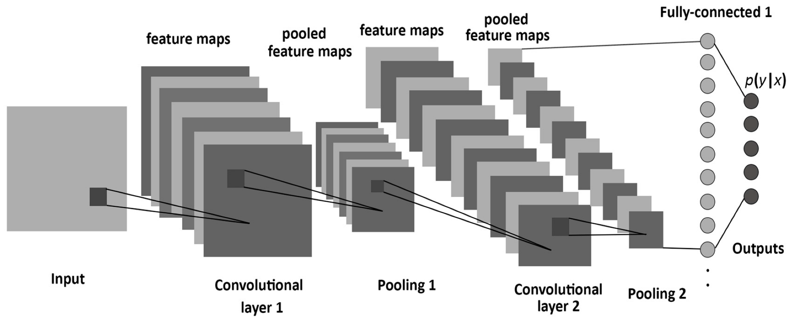
Convolutional Neural Networks (CNN)
CNNs use filter convolution to extract features from images and other data, compress the dimension, and use the results for classification, object detection, etc.
From: https://www.mdpi.com/1099-4300/19/6/242
Tutorials:
https://www.youtube.com/watch?v=oI2rvjbzVmI
http://cs231n.github.io/convolutional-networks/

Slide 12
CNN Components
The Input Layer provides the data to be processed (usually image, video frame, or text)
From: https://www.mdpi.com/1099-4300/19/6/242

Slide 13
CNN Components
A Convolutional Layer has several sub-layers, each representing a filter mask convolved with the entire input image in parallel.
Each filter mask is typically much smaller than the input image.
Each sub-layer applies the mask at regularly spaced patches on the image, and returns a resulting image.
From: https://www.mdpi.com/1099-4300/19/6/242

Slide 14
CNN Components
A Pooling Layer samples k×k patches of each preceding convolutional sub-layer, and produces a single number for each patch (e.g., maximum value in the patch = max-pooling).
The pooling process is a type of sub-sampling.
From: https://www.mdpi.com/1099-4300/19/6/242

Slide 15
CNN Components
Convolution layers and pooling layers typically alternate in the network.
Each convolutional layer extracts higher order features from the previous layer (as in the visual system).
This process can be seen as “squeezing out” significant information from the original image.
From: https://www.mdpi.com/1099-4300/19/6/242

Slide 16
CNN Components
Typically, the final pooling layer output is input to a classifier or some other functional module.
The CNN allows this function to operate on a smaller set of relevant features rather than the raw image/data.
From: https://www.mdpi.com/1099-4300/19/6/242

Slide 17
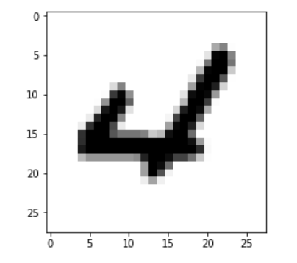
Convolution
28×28 image
The filter is applied to patches of the image in a grid.
4×4 filter
Each patch feeds a neuron in the convolution sub-layer for that filter.
Feature map

Slide 18
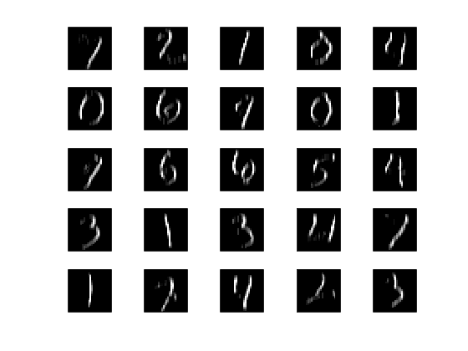
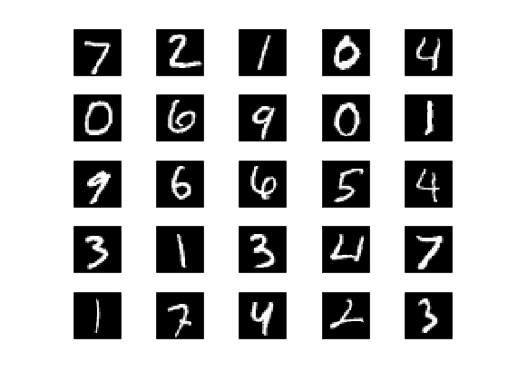
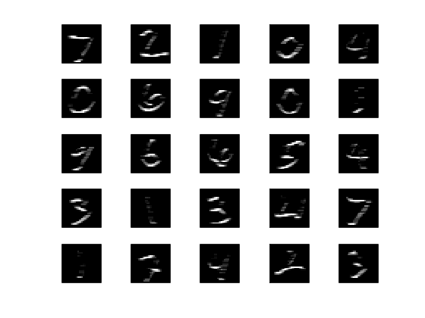
Filters
Images
0
-1
1
0
0
-1
1
0
0
-1
1
0
0
-1
1
0
0
0
0
0
-1
-1
-1
-1
1
1
1
1
0
0
0
0

Slide 19
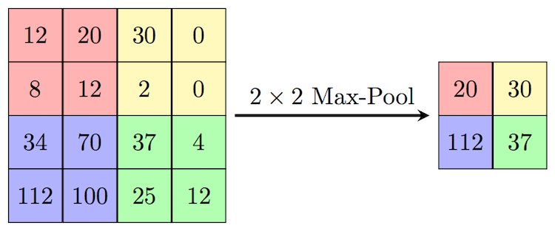
Max Pooling
Sample k×k patches of the image in a grid.
Find the maximum pixel value in each patch.
Output a smaller image where each patch is replaced by a single pixel with the max value from the patch.
Source: https://computersciencewiki.org/index.php/Max-pooling_/_Pooling
(Sometimes it might make sense to do mean pooling)

Slide 20
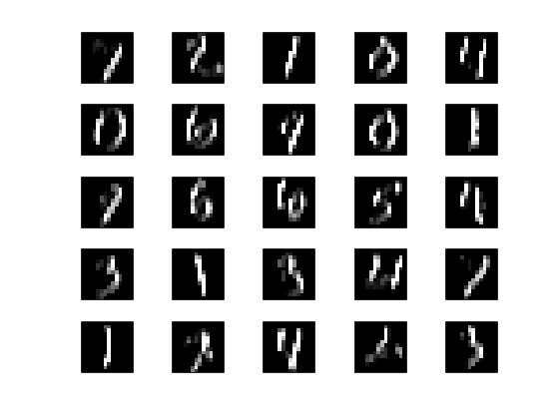
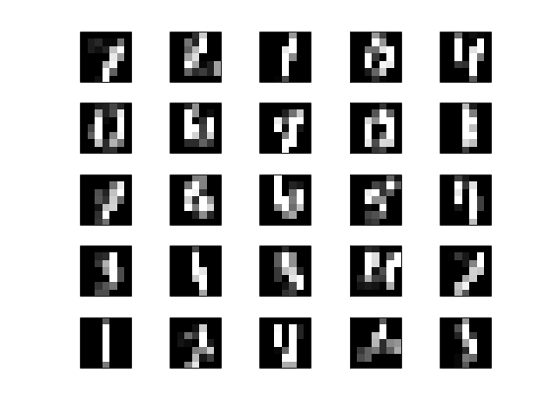
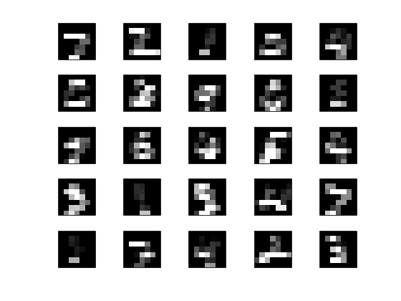
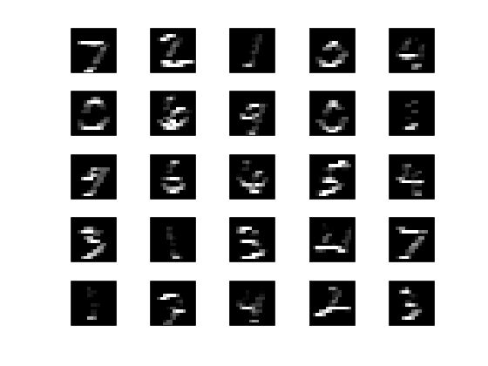
Maxpool 2
Maxpool 4
14×14
7×7
28×28
7×7
14×14
Maxpool 4
Maxpool 2

Slide 21
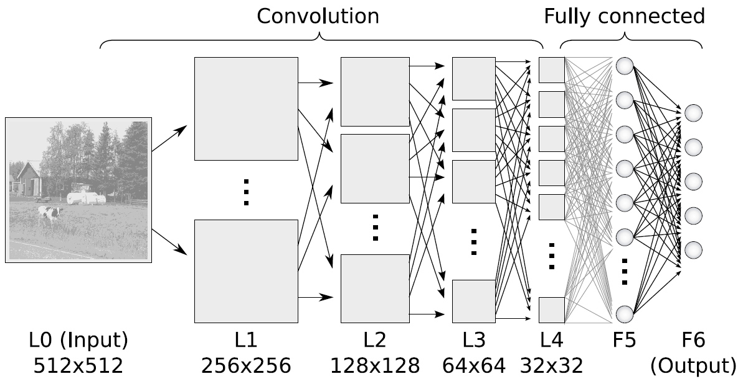
https://www.ais.uni-bonn.de/deep_learning/images/Convolutional_NN.jpg

Slide 22
Belief Networks
The Inference Problem:
Inferring the state of the hidden variables
Stochastic hidden variables (h = causes)
The Learning Problem:
Finding a set of interactions (weights) among the variables that make the observed variable states most likely.
Ideally, we want to infer the joint distribution P (v, h)
For example, we could try maximizing
Observed variables (v = effects)
but, while estimating P(v) is easy, estimating P(h|v) is not.
Restricted Boltzmann Machines
An excellent but complex tutorial: https://www.cs.toronto.edu/~hinton/nipstutorial/nipstut3.pdf

Slide 23
Restricted Boltzmann Machine
The Restricted Boltzmann Machine (RBM) is a stochastic 2-layer bipartite recurrent network with symmetric weights: w_{ij} = w_{ji}
Hidden Layer
h = [ h₁ h₂ …. h_{m} ]
h
W
1
2
3
n
v
v = [ v₁ v₂ …. v_{n} ]
Visible (Input) Layer
RBMs are used to infer latent (hidden) variables
For a nice introduction, see:
https://towardsdatascience.com/deep-learning-meets-physics-restricted-boltzmann-machines-part-i-6df5c4918c15

Slide 24
Binary (0/1) RBM
Hidden neuron i:
net input to i at step t
probability of i being
active at step t
1
2
3
n
Visible neuron j:
net input to j at step t
probability of j being
active at step t

Slide 25
Training with Contrastive Divergence
Get hidden pattern
From hidden pattern
Get updated hidden pattern
h(0) ≡ h⁺
h(0)
h(1)
W
W
W
k steps
v(0) ≡ v⁺
v(1)
v(1)
Apply an actual input
Get reconstructed input
From reconstructed input
Get final hidden pattern
h(k) ≡ h⁻
W
v(k) ≡ v⁻
For each input or in mini-batches.
Usually, k = 1 is enough.
From final reconstructed input

Slide 26
Deep Belief Networks
DBN
h^{q}
h¹
h²
h^{q}
W ^{q}
h^{q-1}
W ¹
W ²
W ^{q}
v
h¹
h^{q-1}
h²
The h^{q} pattern is a deep latent representation of the input.
The DBN is a generative model – it generates new data that follows the distribution of the training data.
W ²
h¹
h¹
W ¹
v
https://www.cs.toronto.edu/~hinton/nipstutorial/nipstut3.pdf

Slide 27
How does a DBN work?
DBN
h^{q}
Randomly initialize the top two layers h^{q} and h^{q-1}
Iterate these two layers until convergence (Gibbs sampling)
Propagate the activity down from h^{q-1} to v to obtain a sample of the observable variables.
W ^{q}
h^{q-1}
Why is this useful?
It explains where the observable variables come from.
It provides a deep set of latent causes for the observed data.
The latent variables can be used as features for further inference about the observable data.
h²
W ²
h¹
h¹
W ¹
v

Slide 28
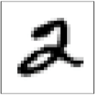
An Example: MNIST Classifier
Randomly initialize Labels layer.
Present data input and propagate up to h^{q}
Iterate the recurrent associative memory at the top until convergence.
Read the inferred label from the Labels layer (label can be seen as a “corrected” part of the [h^{q-1} h^{q} Label] memory vector)
h^{q}
W ^{q}
U
h^{q-1}
1-hot Labels
h²
We can also “verify” the label by then running the DBN down from to see if the right class of digit is generated.
This allows us to generate novel samples of each digit, i.e., digits that the network “believes” are 2s or 7s or 0s.
W ²
h¹
h¹
W ¹
v

Slide 29
Deep Autoencoders from DBNs
v
Deep autoencoders can be learned in an unsupervised way by training several RBMs, stacking them, and “unfolding” the stack.
W ¹
h¹
W ²
h¹
h²
h³
h²
W ¹
W ²
W ³
W ³
h³
v
h¹
h²
W ³
h²
W ¹
W ²
W ³
W ²
v
h¹
h²
h³
h¹
W ¹
v
Detailed tutorial:
https://www.cs.toronto.edu/~hinton/nipstutorial/nipstut3.pdf

